Slide 1
PROJECT TITLE :- PSCS235 A one Stop Solution focusing on Tourism
PIP2001 Capstone Project
Review-1
Batch Number: CIT-G06
Student Name | Roll Number
Puneeth N | 20221LIN0004
Rohan Gowda A | 20221LIN0003
Ajin V Joseph | 20221LIN0007
Under the Supervision of,
Dr Shanthi S
Associate Professor
School of Computer Science and Engineering
Presidency University
Name of the Program: Btech CSE(IoT)
Name of the HoD: Dr. Anandaraj S P
Name of the Program Project Coordinator: Dr. Sharmasth Vali Y
Name of the School Project Coordinators: Dr. Sampath A K / Dr. Abdul Khadar A / Mr. Md Ziaur Rahman

Slide 2
Introduction
"Travel Eazy" is an advanced Python-based web application that leverages machine learning to provide personalized travel recommendations and a streamlined booking experience for users exploring destinations across India. The platform includes two primary modules: Admin and User. In the Admin module, administrators can add extensive information about tourist attractions, regional cuisine, and popular activities specific to various Indian states, creating a rich, curated database for travellers. Users can register and log in to access this tailored information and receive destination suggestions based on their health conditions and personal preferences, courtesy of a machine learning model. This model assesses user inputs to recommend locations that best align with individual needs and interests, ensuring an enjoyable and optimal travel experience. Additionally, users can easily add their selected destinations to a cart, enabling seamless booking and simplifying the travel planning process. "Travel Eazy" aims to make travel planning accessible, efficient, and highly personalized for every traveller

Slide 3
Literature Review
S . No | Year | Author | Title | Outcomes
1. | 2023 | J. Doe, M. Smith Outcome: | "Personalized Travel Recommendation System Using Machine Learning" | Developed a recommendation system that improved user satisfaction by providing personalized travel destinations based on user preferences.
2. | 2022 | A. Zhang, B. Liu | "An Adaptive Travel Recommendation Model Based on User Health and Preferences" | Provided health-conscious travel recommendations, accurately matching destinations to users' health conditions and preferences.

Slide 4
Literature Review
S . No | Year | Author | Title | Outcomes
3. | 2021 | L. Patel, K. Iyer | "Smart Travel Assistant: Personalized Itinerary Planning Using Artificial Intelligence" | Created a smart assistant offering personalized travel itineraries, simplifying travel planning and enhancing user experience.
4. | 2023 | R. Kaur, N. Verma | "Utilizing Big Data for Enhancing Travel Recommendations in Indian Destinations" | Leveraged big data to suggest popular Indian destinations, achieving high engagement and relevance in recommendations.

Slide 5
Existing System
Currently, traditional travel planning methods often involve extensive research through various platforms, including travel agencies, websites, and social media. Users frequently encounter scattered information, making it challenging to find personalized recommendations tailored to their preferences. Additionally, existing systems often lack real-time updates on tourist attractions and may not cater to specific health considerations or priorities.

Slide 6
Proposed Method
The proposed "Travel Eazy" application addresses the limitations of traditional systems by offering a centralized platform for travel planning in India. Through its Admin module, it provides comprehensive and updated information about tourist destinations and experiences. The machine learning integration allows for personalized travel recommendations based on user inputs, ensuring that travellers receive tailored suggestions.

Slide 7
Advantages of Proposed Method
Personalized recommendations enhance user satisfaction.
Centralized information streamlines research and planning.
Regular updates ensure content relevance.
Simplified booking process through a single platform.
Focus on user health considerations for safer travel.

Slide 8
Significant Proposed Method
The choice to develop " A one stop solution focusing on tourism " stems from the growing demand for personalized travel solutions in an increasingly digital world. As the tourism industry continues to evolve, travelers seek tailored experiences that cater to their individual preferences, health needs, and interests. Leveraging machine learning allows us to create a dynamic platform that not only showcases diverse tourist attractions across India but also curates recommendations that enhance user satisfaction.
Additionally, the project aligns with the rapid advancements in technology and the rise of data-driven decision-making. By integrating machine learning, " A one stop solution focusing on tourism " can analyze user inputs to suggest optimal travel experiences, addressing gaps in traditional travel planning methods that often lack personalization.
Furthermore, the focus on Indian tourism highlights the rich cultural and geographical diversity of the country, promoting local attractions and cuisine. This not only supports local economies but also fosters a deeper appreciation for India's heritage among both domestic and international travelers. Ultimately, this project aims to bridge the gap between user preferences and travel options, making travel planning more efficient, enjoyable, and accessible.

Slide 9
Objectives
The primary objective of "Travel Eazy" is to develop an intuitive web application that enhances the travel planning experience for users in India through the integration of machine learning and a robust administrative interface. By allowing administrators to add and manage comprehensive information about tourist destinations, local cuisine, and activities, the project ensures that users have access to valuable and up-to-date resources. The machine learning component aims to personalize user experiences by analysing individual preferences and health-related inputs to provide tailored travel recommendations. Furthermore, the application seeks to simplify the booking process, allowing users to seamlessly add chosen destinations to a cart and finalize travel arrangements. Overall, "Travel Eazy" aims to streamline the travel planning journey, making it more efficient, user-friendly, and accessible for a diverse range of travellers.

Slide 10
Methodology
Existing digital marketplaces for artisans typically feature role-based user management, enabling admins to oversee platform operations, artisans to showcase and manage their products, and customers to browse and purchase items. They utilize modern technologies like React.js for responsive frontends, Spring Boot for scalable back ends, and MySQL for reliable data storage. Additionally, these platforms support community interactions, event management, promotional tools, and secure checkout processes to enhance user experience and foster artisan growth

Slide 11
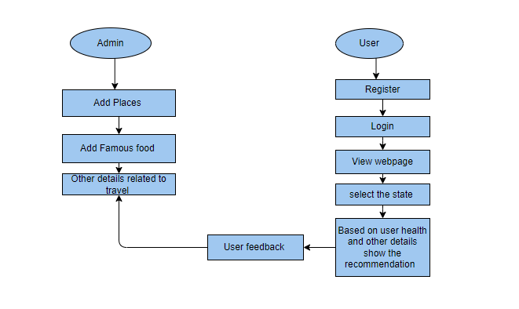
Flow Diagram

Slide 12
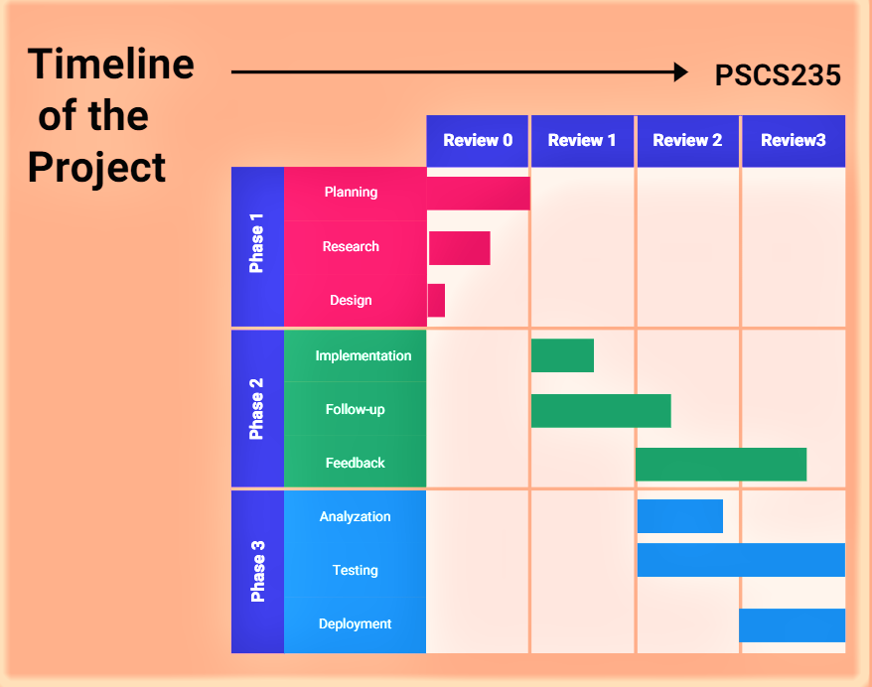
Timeline of Project

Slide 13
Conclusion
The scope of this project is to encompasses several key areas aimed at revolutionizing travel planning in India. Firstly, the project will provide a comprehensive database of tourist destinations, local cuisine, and activities, ensuring that users have access to a wide range of information. The Admin module is designed to be robust, allowing for easy updates and additions to the database, which ensures that the content remains relevant and up-to-date.
Secondly, the implementation of a machine learning model serves as a core feature, enabling personalized travel recommendations based on user inputs, such as health conditions and personal preferences. This not only enhances user experience but also promotes informed decision-making in travel planning.
Additionally, the user interface will be designed to be intuitive and user-friendly, allowing seamless navigation and engagement with the application. The project also includes a booking feature, which integrates travel arrangements into the platform, creating a one-stop solution for users.
Lastly, future expansions could involve incorporating user reviews, ratings, and additional functionalities such as itinerary planning and integration with external travel services, broadening the application's appeal and usability.

Slide 14
References
Deepanjal Shrestha et al., "Personalized Tourist Recommender System: A Data-Driven and Machine-Learning Approach," Computation, 2024, DOI: 10.3390/computation12030059.
J. Karthiyayini, R. J. Anandhi, "Machine Learning for Tourism Recommendation System (TRS)," SN Computer Science, 2024, DOI: 10.1007/s42979-024-02667-x.
Yang Song, Yingwei He, "Toward an Intelligent Tourism Recommendation System Based on Artificial Intelligence and IoT Using Apriori Algorithm," Soft Computing, 2023, DOI: 10.1007/s00500-023-09330-2.
Zahira Chouiref, Mohamed Yassine Hayi, "Toward Preference and Context-Aware Hybrid Tourist Recommender System Based on Machine Learning Techniques," Revue d'Intelligence Artificially, 2022, DOI: 10.18280/ria.360203.
Mohamed Badouch, Mohamed Elhadi Rahmani, "Personalized Travel Recommendation Systems: A Study of Machine Learning Approaches in Tourism," Journal of Artificial Intelligence and Neural Networks, 2023, DOI: 10.55529/jaimlnn.33.35.45.

Slide 15
References
S. S. S. R. K. S. K. S. S., "Improvising Personalized Travel Recommendation System with Recency Effects," IEEE ICCMC, 2021, DOI: 10.1109/ICCMC51019.2021.9418380.
X. X. X., "Personalized Tourist Route Recommendation Model with a Trajectory Encoding and Temporal Attention Mechanism," International Journal of Digital Earth, 2022, DOI: 10.1080/17538947.2022.2130456.
X. X. X., "Design and Implementation of a Personalized Tourism Recommendation System Based on the Data Mining and Collaborative Filtering Algorithm," Scientific Programming, 2022, DOI: 10.1155/2022/1424097.
Ngai Lam Ho, Kwan Hui Lim, "Utilizing Language Models for Tour Itinerary Recommendation," arXiv preprint, 2023, DOI: 10.48550/arXiv.2311.12355.
Ngai Lam Ho, Roy Ka-Wei Lee, Kwan Hui Lim, "SBTRec: A Transformer Framework for Personalized Tour Recommendation Problem with Sentiment Analysis," arXiv preprint, 2023, DOI: 10.48550/arXiv.2311.11071.

Slide 16
Thank You

